Slide 1
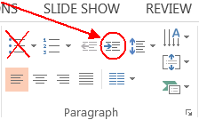
How to use this presentation template
DELETE THIS PAGE BEFORE PRINTING OR PRESENTING!
Here are some important tips for properly creating a PowerPoint presentation:
1) DO start with the eight sample slides that are already here (look/click in the Slide Sorter window at left). Their placeholder Titles are the same as their eight respective Layouts.
2) To add a new slide, either duplicate a slide that’s already in the Slide Sorter by right-clicking on the thumbnail and choosing Duplicate Slide, or create a new slide by going to HOME > Slides > New Slide, and choose a Layout from the dropdown.
3) DON’T CREATE NEW LAYOUTS. This is a template. Please use the existing Layouts.
4) DON’T USE AD HOC FORMATTING. Again, this is a template. Keep the headline, subhead and body formats as they are (don’t center them, don’t change the font, don’t add shadow, etc.).
5) To indent/add bullets, always DO USE THE DECREASE LEVEL button! This will automatically format your bullets and lists. There are only three levels of text: 1) No bullet/blue, 2) bullet/gray, and 3) bullet/gray DON’T USE THE BULLETS button! or your text/lists/bullets won’t be formatted to match the template.
Why is this important? If we update the template with new fonts etc., or if you ever have to copy a presentation into a new template, it will format correctly, automatically!

Slide 2
Section Divider Slide

Slide 3
Microsoft Azure Governance Hackshop
Notes:
Add name of primary proctor and their tile to this slide

Slide 4
What the Hack?!
Microsoft Azure Governance Hackshop
Welcome & Intro’s
<Insert Name & Title>
<Insert Name & Title>
<Insert Name & Title>
<Insert Name & Title>
Notes:
All proctor’s and team members should do a quick introduction of their name, title and role in today’s hackshop. Customer attendee’s should do a quick intro of name, title, team they work with and what they are hoping to get out of today’s hackshop

Slide 5
What the Hack?!
What Is The Agenda For Today?
Organization Hierarchy
Management Groups
Subscriptions
Resource Group
Naming Conventions & Standards
Tags
Azure Policy
Azure Blueprints
Identity & Access Management
Notes:
Clearly state that the attendee’s may not get all the way through this today (and the expectation is that most or not any of them will make it all the way to the end. Explain that this is not a traditional workshop where we would stand up and give a presentation and then they would work through a checklist of steps. This is a challenge based hackathon focused on learning topics and applying them to your business. The challenges describe high-level goals and tasks to be accomplished. Proctor’s are here to provide guidance (not answers) unless there is something blocking progress. Proctor’s will force you to learn the content rather than providing answers.

Slide 6
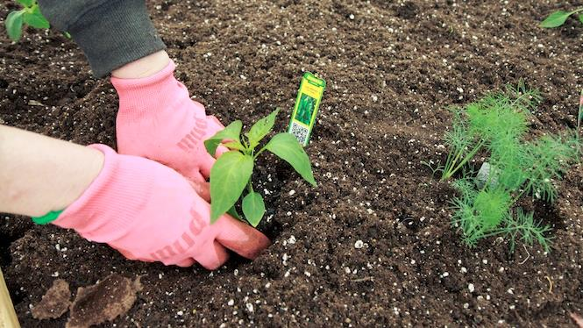
You Will Get Your Hands Dirty!
Notes:
You only get out what you put in, don't be lazy.
Knowledge Retention through Pain and Discomfort

Slide 7
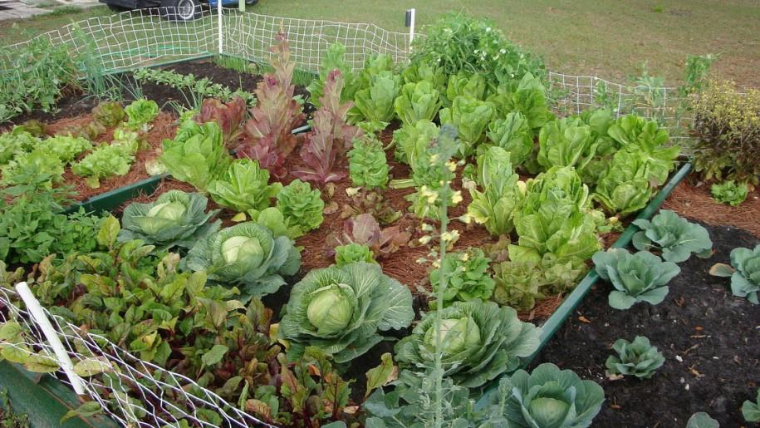
What Will Your Garden Look Like?
Notes:
You might not grow a garden like this… but at least you can learn while trying.

Slide 8

Logistics

Slide 9
Format
Challenges are cumulative, building upon each other.
Establish Confidence – start small and simple (think hello world)
Build Competence – by having successively more complex challenges
Challenges are NOT step-by-step hands on labs!
No “clicking here” or “copy n pasting there”
Challenge definitions are short. A couple of sentences or bullet points stating the end goal(s) and perhaps a hint at the skill(s) needed.
You MUST work together as a team to figure out how to complete them!

Slide 10
Format
For each challenge we will deliver a “mini-lecture” explaining the concepts in it
We’ll review each challenge when it looks like a majority of folks have completed the challenge
Don’t worry about how much time something is taking!
Move quickly or take it slow. Your proctors are here to help
Remember, the focus is on learning!
There WILL be more challenges than you can complete in our allotted time! These are takeaways to follow up on.

Slide 11
Tooling
You can use any tooling you want, but we strongly encourage (and will only support the following):
Visual Studio Code
Azure PowerShell
Azure CLI
Azure Cloud Shell

Slide 12
Finding Answers
Search engines are your friend! Azure is a hot technology and much ink has been spilled on it.
The Azure docs are your best bet!

Slide 13
Proctor Responsibilities
Keep the teams working as teams!
Encourage all to “learn from” and “share with” each other!
If you observe individuals racing ahead, encourage them to help those who are behind.
Unblock teams who get stuck
Encourage team members to unblock each other first!
Provide hints, but not answers
Provide hints/pointers to the teams on how to solve problems & where to find information.

Slide 14
Hack Attendees Responsibilities
Learn
Do
Learn
Share

Slide 15
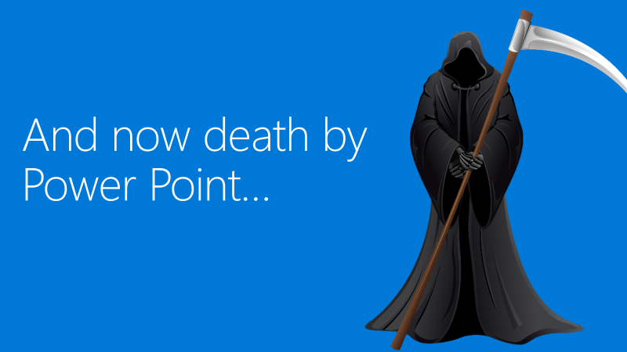

Slide 16
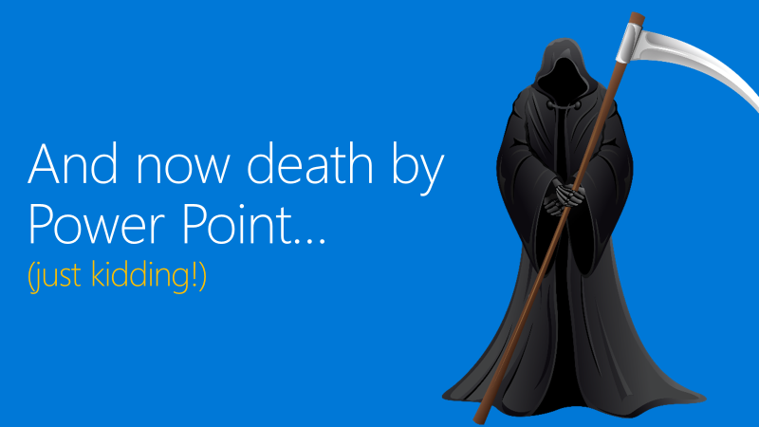

Slide 17
Header Only

Slide 18
Object Slide

Slide 19
Double Column Slide

Slide 20
Double Column with Header Slide

